Slide 1

An Accessible Open-Source Implementation of the Congruent Matching Cells Algorithms for Cartridge Case Analysis
11:05-11:20 D38
Joseph Zemmels, Susan VanderPlas, Heike Hofmann

Slide 2
Overview
Cartridge case analysis
Algorithms & open-source code
The Congruent Matching Cells pipeline
The cmcR package
CMC pipeline experimentation

Slide 3
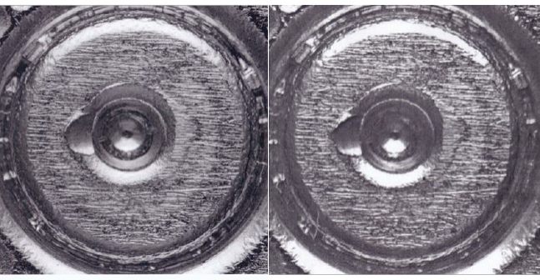
Cartridge Case Analysis

Slide 4
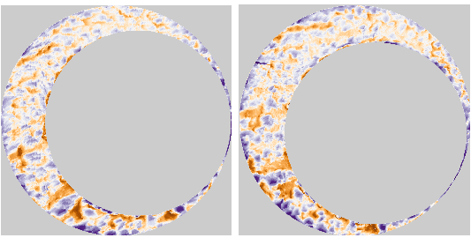
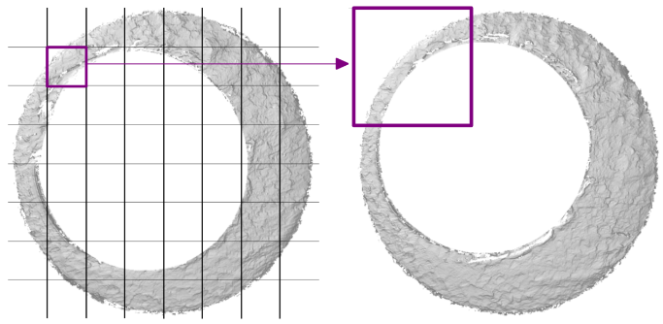
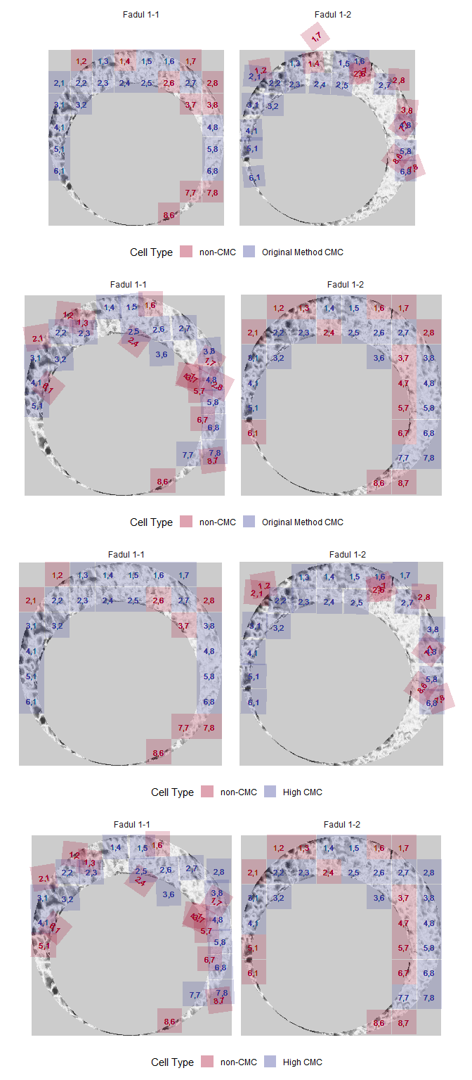
Algorithms as Data-to-Results Pipelines
Algorithm: A set of instructions used to perform a computation.
Each instruction can be thought of as a step in an overall pipeline
Can be used to compute the similarity between pieces of evidence
Initial Data
Pre-processing
Comparison
Final Results

Slide 5
What are Open-Source Algorithms?
Code is freely available for investigation and experimentation
Open-source algorithms encourage reproducibility of results
Reproducibility
“Obtaining consistent computational results using the same input data, computational steps, methods, code, and conditions of analysis.” (NASEM, 2019)
Reproduction of results is required to establish error rates, etc.

Slide 6

The Congruent Matching Cells Algorithms
Developed at NIST in 2013 with additional changes/improvements since
Divide one scan into a grid of “cells”
Compare each cell to another cartridge case
Classify cells as “congruent matching” if they match the other scan
Measure similarity as the total number of “Congruent Matching Cells” (CMCs)

Slide 7
The cmcR package
Modularizes the CMC method into an explicit pipeline:
Initial Data %>% First Function %>% Second Function %>% ...
Created using the R statistical programming language
Available for free on the Comprehensive R Archive Network

Slide 8
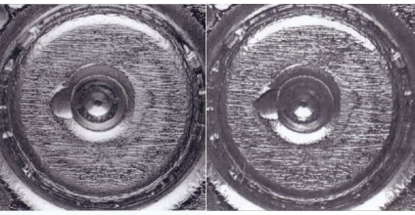
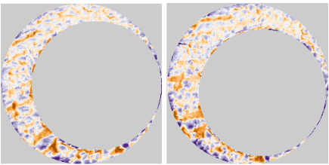

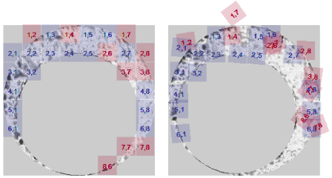
cmcR *Pipe*line
Initial Data %>%
Pre-processing %>%
Comparison %>%
Final Results
preProcess_crop() %>%
Cartridge Cases %>%
preProcess_removeTrend() %>%
comparison_allTogether() %>%
decision_CMC()
preProcess_gaussFilter() %>%

Slide 9
CMC Pipeline Experimentation
Modularization enables experimentation with particular steps
[Include picture with/without trends removed from two matches]
preProcess_crop() %>%
Cartridge Cases %>%
preProcess_removeTrend() %>%
comparison_allTogether() %>%
decision_CMC()
preProcess_gaussFilter() %>%

Slide 10
CMC Pipeline Experimentation
[(Time permitting) show experimental results across many parameter changes. Demonstrate that this can be used to select the “best” settings for the algorithm]

Slide 11
Resources
cmcR Source Code: https://github.com/CSAFE-ISU/cmcR
NIST Database: https://tsapps.nist.gov/NRBTD/Studies/Search
Intro to R resources

Slide 12
References

